Slide 1
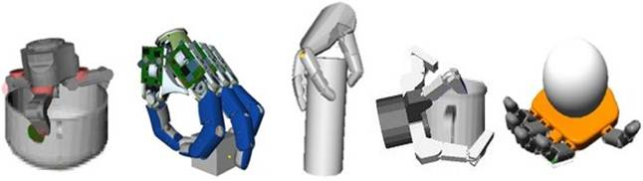
Internal Grasp Forces &
Metrics for Optimal Grasps
Niccolo, Mattia, Jasmine

Slide 2
What makes a grasp good?
Point contact without friction
So far, we’ve seen:
Form Closure
Complete kinematic restraint even without friction

Slide 3
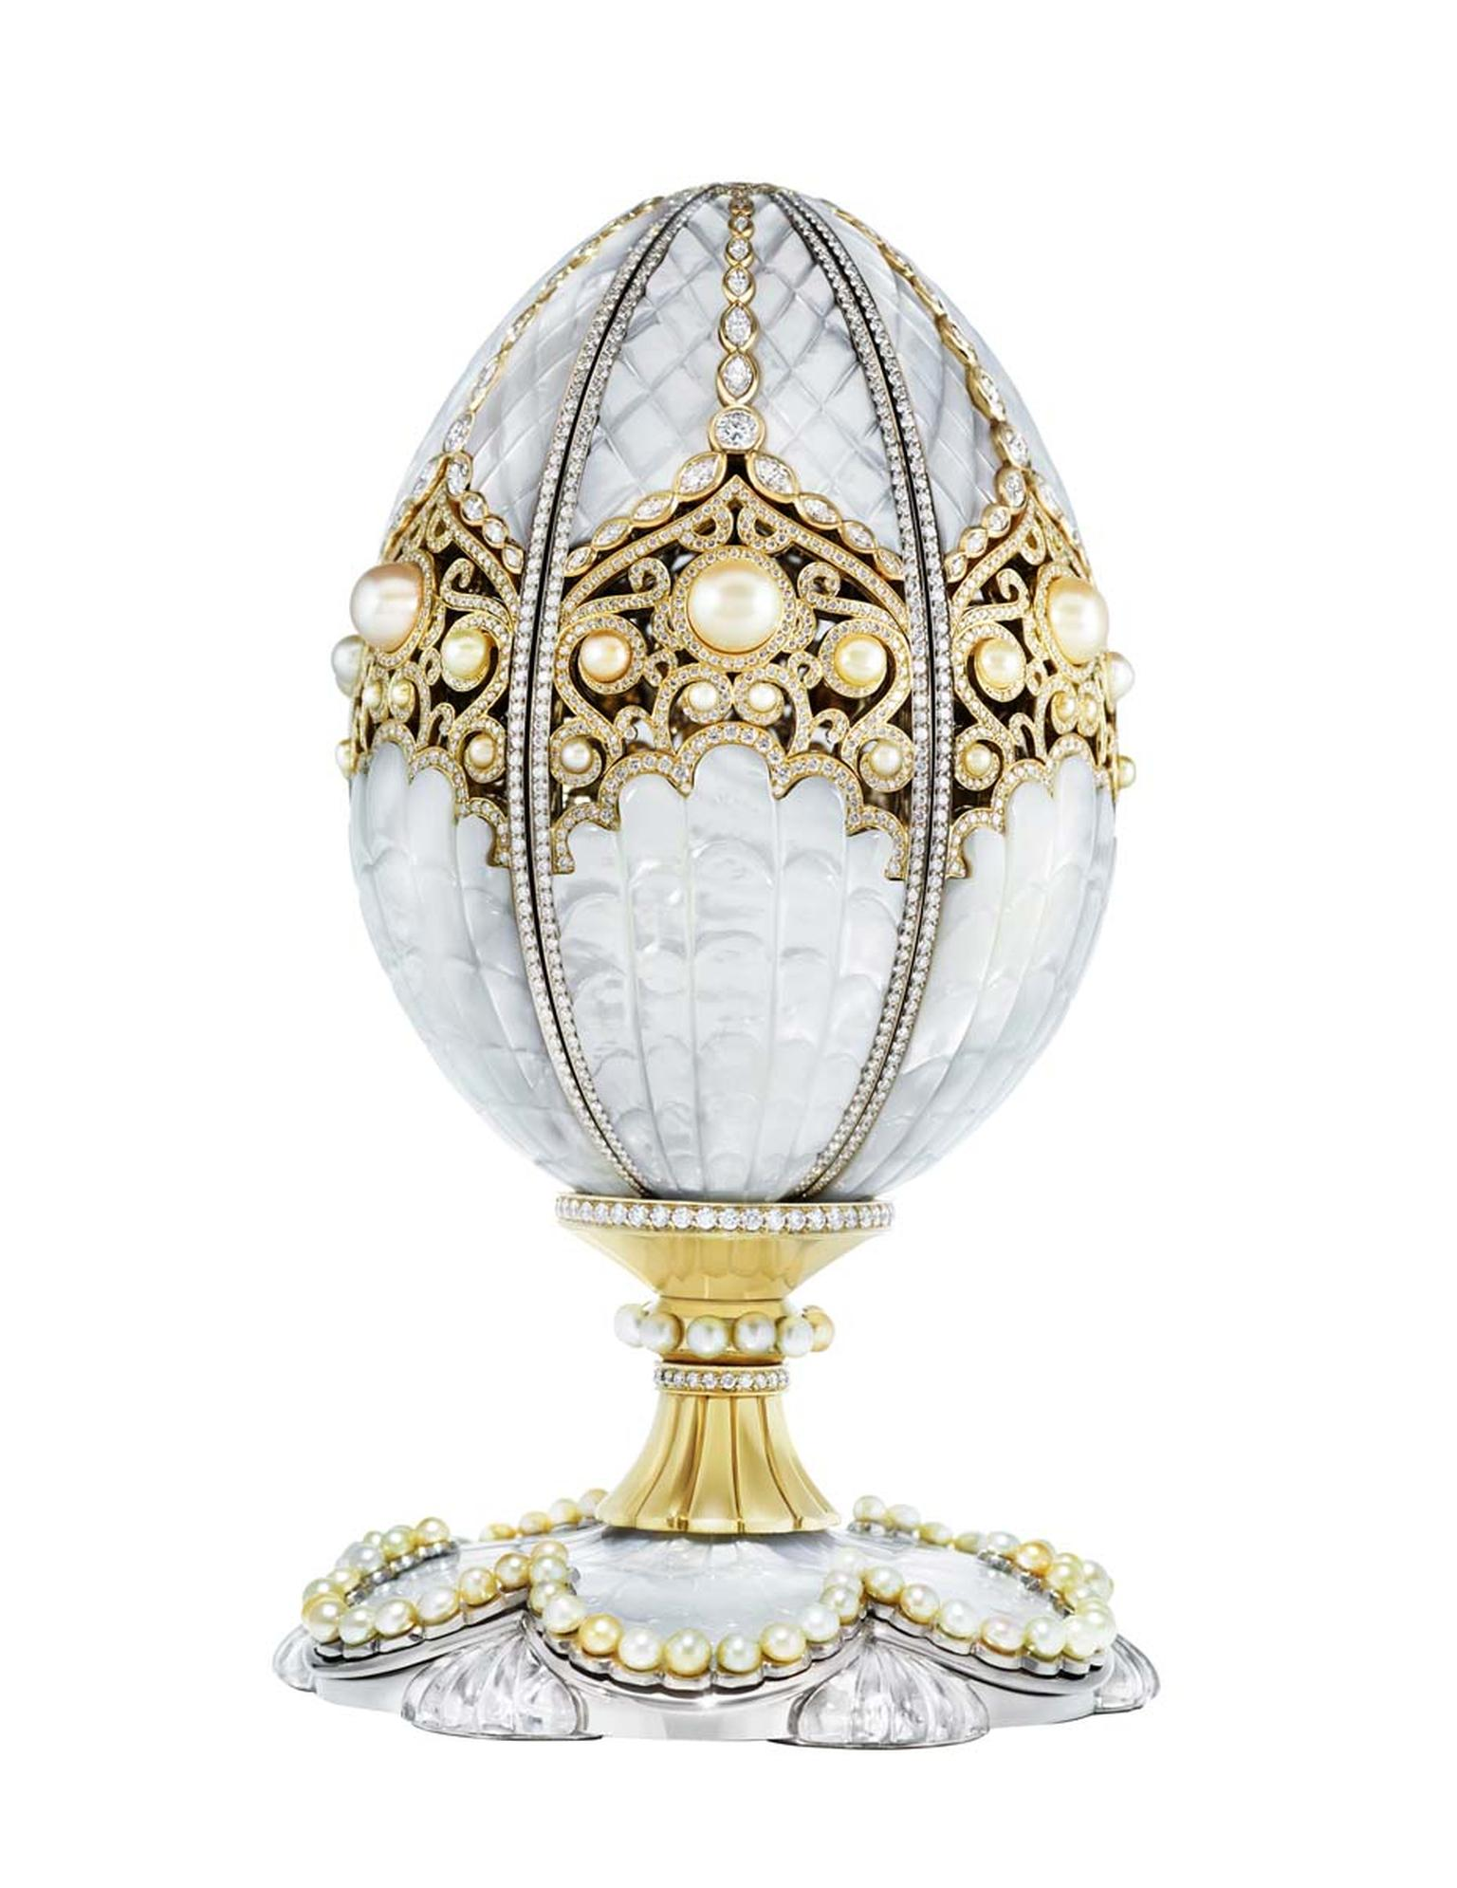
What makes a grasp good?
So far, we’ve seen:
Form Closure
Complete kinematic restraint even without friction
Easy to check, but very conservative.

Slide 4
What makes a grasp good?
Point contact without friction
Point contact with friction
So far, we’ve seen:
Form Closure
Force Closure
Complete kinematic restraint even without friction
Complete kinematic restraint assuming frictional forces
Easy to check, but very conservative.

Slide 5
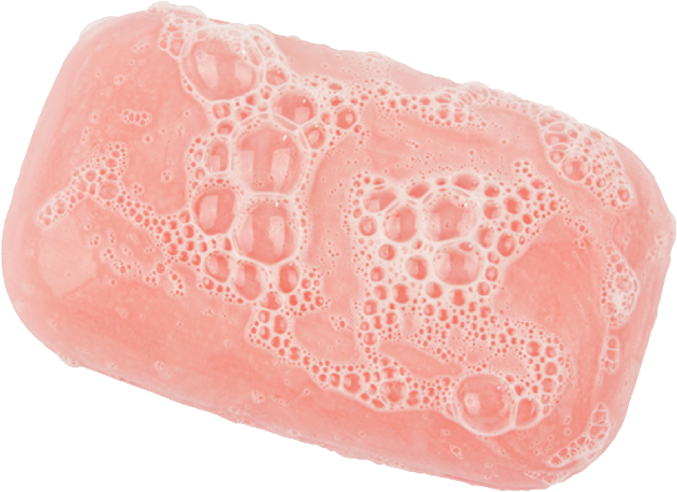
What makes a grasp good?
Point contact without friction
Point contact with friction
So far, we’ve seen:
Form Closure
Force Closure
Complete kinematic restraint even without friction
Complete kinematic assuming frictional forces
Easy to check, but very conservative.
Easy to check, but not a sufficient condition (why?)
Assuming you can apply unlimited normal force

Slide 6
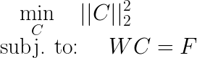
Yoshikawa & Nagai (1991)
So far, we’ve simply considered minimizing the ℓ₁ or ℓ₂-norm
Leads to simple pseudo-inverse W† result.
But now consider the physical meaningfulness of solutions.
Notes:
\min_{C} \quad ||C||_2^2\\
\textrm{subj. to: } \quad WC = F

Slide 7
Recap: External and Internal Forces
So far, the contact forces we solve correspond to two sets of forces:
External Forces
Internal Forces
Notes:
Grasp Matrix

Slide 8
Recap: External and Internal Forces
So far, the contact forces we solve correspond to two sets of forces:
“Manipulating force”
“Grasp force”
Notes:
Grasp Matrix

Slide 9
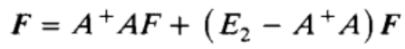
Simple 2-fingered hand
Yoshikawa & Nagai (1991)
We’ve seen that the problem can be decomposed like this
f₂
mg
External Forces
Internal Forces
f₁
Notes:
\min_{C} \quad ||C||_2^2\\
\textrm{subj. to: } \quad WC = F

Slide 10
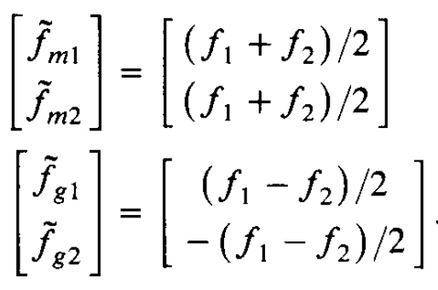
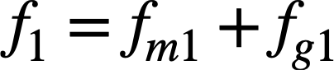
Simple 2-fingered hand
Yoshikawa & Nagai (1991)
-f₂
Up to this point, people thought of the external forces as “manipulating forces” and the internal forces as “grasp forces.”
mg
Manipulating force
f₁
Grasp force
Notes:
\min_{C} \quad ||C||_2^2\\
\textrm{subj. to: } \quad WC = F

Slide 11
Suppose the top finger force goes to 0
-f₂
What happens in case f₂ ~ 0 and f₁ > 0?
f₁
Notes:
\min_{C} \quad ||C||_2^2\\
\textrm{subj. to: } \quad WC = F

Slide 12
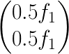
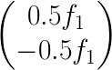
Does this make sense?
f₂
f₁
Notes:
\min_{C} \quad ||C||_2^2\\
\textrm{subj. to: } \quad WC = F

Slide 13
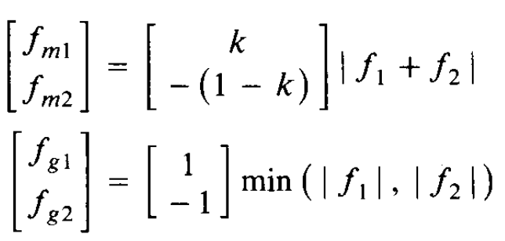
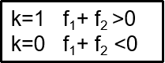
Yoshikawa & Nagai (1991)
Yoshikawa & Nagai (1991) propose a new, nonlinear definition for grasp force and manipulating force that makes more sense intuitively
f₂
f₁
Notes:
\min_{C} \quad ||C||_2^2\\
\textrm{subj. to: } \quad WC = F

Slide 14
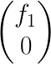
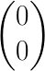
Does it make more sense now?
f₂
f₁
Notes:
\min_{C} \quad ||C||_2^2\\
\textrm{subj. to: } \quad WC = F

Slide 15
Demo
:)
Physical demo with le mani?

Slide 16
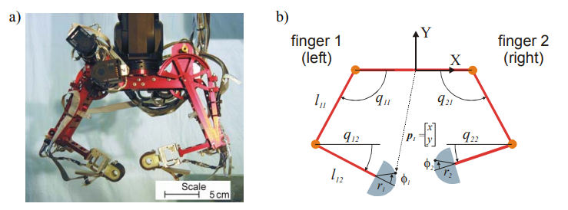
As used in the Dexter hand (W. Griffin thesis)

Slide 17
Harvard Hand example in assignment
Firm mode:
[Kx] is relatively high
kf is not too high (let internal force vary if needed)
Clingy mode:
[Kx] is soft (let object comply)
kf is relatively high (control internal force vigorously)
HandControl.m
%Object stiffness
Kx = [ 1 0 0 ;
0 1 0 ;
0 0 1 ;];
%Commanded external forces
F_ext = Fe_bias - Kx*dx_obj;
% Commanded internal forces
f_int = fi_des + kf*(fi_des - fi_meas);
%Total forces [Fex, Fey, Me, Fint]
F_obj = [F_ext;
f_int];

Slide 18
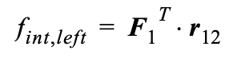
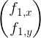
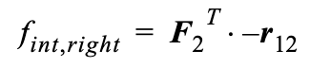
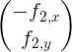
As used in the Dexter hand (W. Griffin thesis. p190)
Left-internal force
Right-internal force
Then internal force is:
Notes:
f_{\textrm{int}} = \min ( f_{\textrm{int,left}}, f_{\textrm{int,right}})
\begin{pmatrix} f_{1,x}\\ f_{1,y}\end{pmatrix}

Slide 19
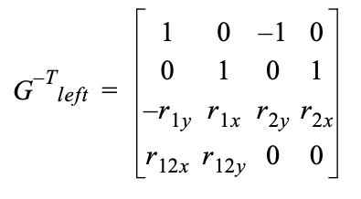
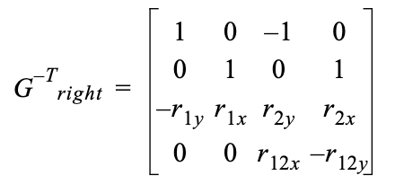
As used in the Dexter hand (W. Griffin thesis. p190)
Having determined f_{int}, choose grasp transformation correspondingly

Slide 20
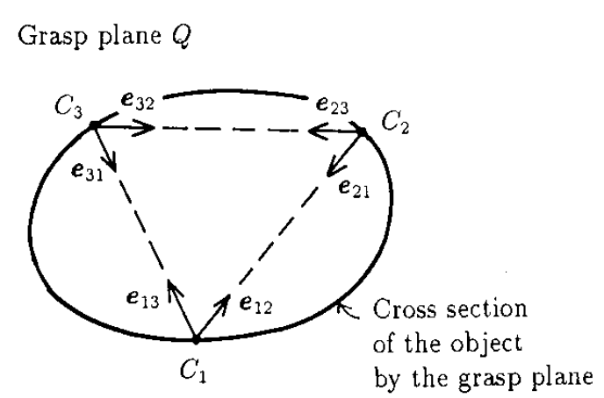
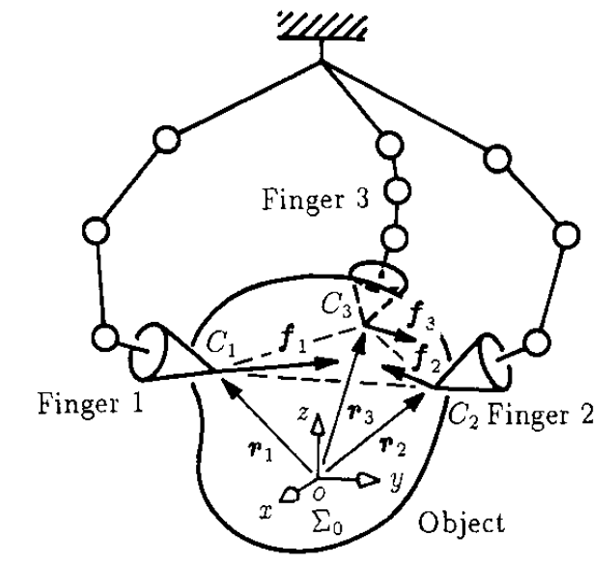
Yoshikawa & Nagai (1991)
Three-fingered hand and object
Insight: fingertip forces lie along the vectors between the points of contact
But it gets considerably more complicated with more fingers and today we would probably just solve a fast optimization problem with explicit constraints due to friction (as well as maximum joint torques, etc.).

Slide 21
What makes a grasp good?
Point contact without friction
Point contact with friction
So far, we’ve seen:
Form Closure
Force Closure
Complete kinematic restraint even without friction
Complete kinematic assuming frictional forces
Easy to check, but very conservative.

Slide 22
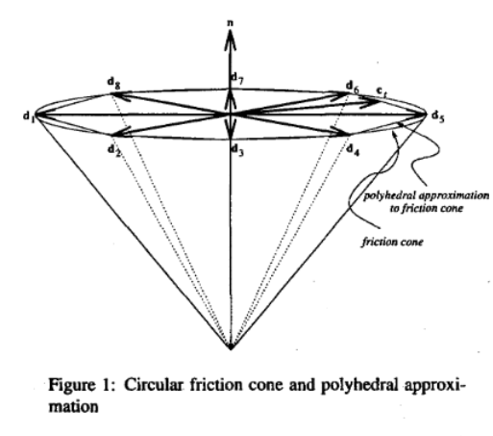
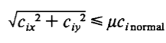
What about friction?
Stewart & Trinkle (2000)
Notes:
Friction cone is convex; this is something Rachel will go into more detail later in how this can be exploited.

Slide 23
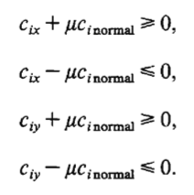
LP Reformulation as a pyramid
Incorporate friction cone constraint into linear program from last time
Second-order cone constraint → linearize
Now consider additional constraints
Linearize
(solvers have trouble with “pointy” end)

Slide 24
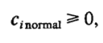
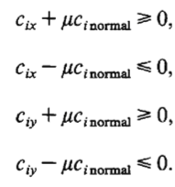
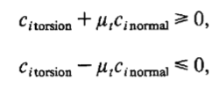
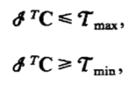
Kerr & Roth (1986)
Normal force constraint
Friction cone constraint
Torsion constraint
Joint torque constraints

Slide 25
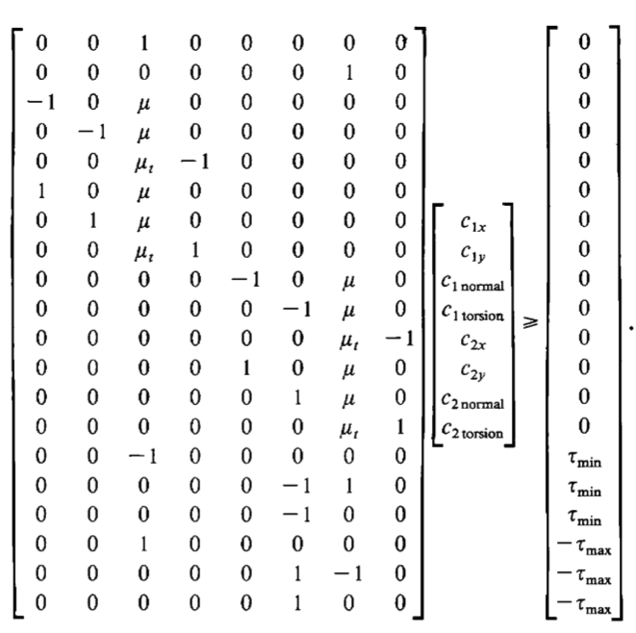
Kerr & Roth (1986)
Normal force constraint
Friction cone constraint
Torsion constraint
Joint torque constraints
Solve using numerical optimization!

Slide 26
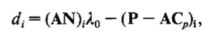
Intuitively...
Now introduce notions of optimality
Distance from a solution λ₀ to constraint plane i
Notes:
Distance of a solution \lambda_0 from the i’th constraint plane.

Slide 27
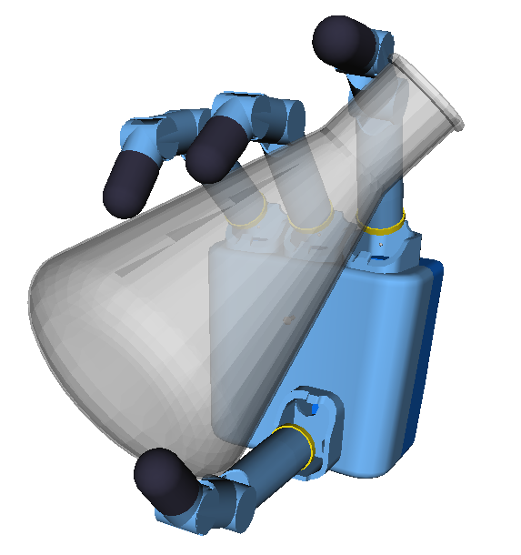
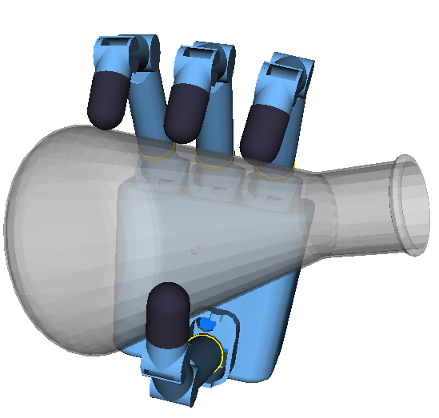
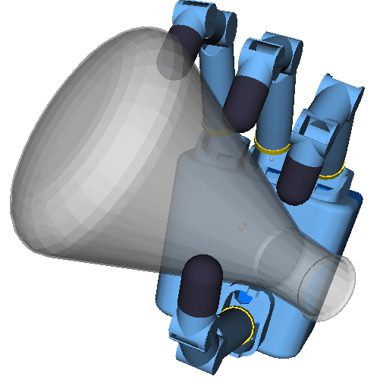
Ferrari-Canny Metric
Ferrari and Canny suggest a grasp quality metric that is very fast to compute, so it can be used to evaluate many grasps while searching the grasp space.
Given a grasp on an object and knowledge of the coefficient of friction between the object and the fingers
Compute a metric, Q, that represents the task-agnostic quality of the grasp
Notes:
Also, we want a fast way to compute this metric so we can evaluate many grasps while searching

Slide 28
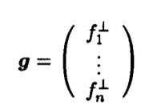
Setup: generalized grasp force
Notation in the paper:
What it means:
We are given a grasp with n contact points and some normal force applied at each contact.

Slide 29
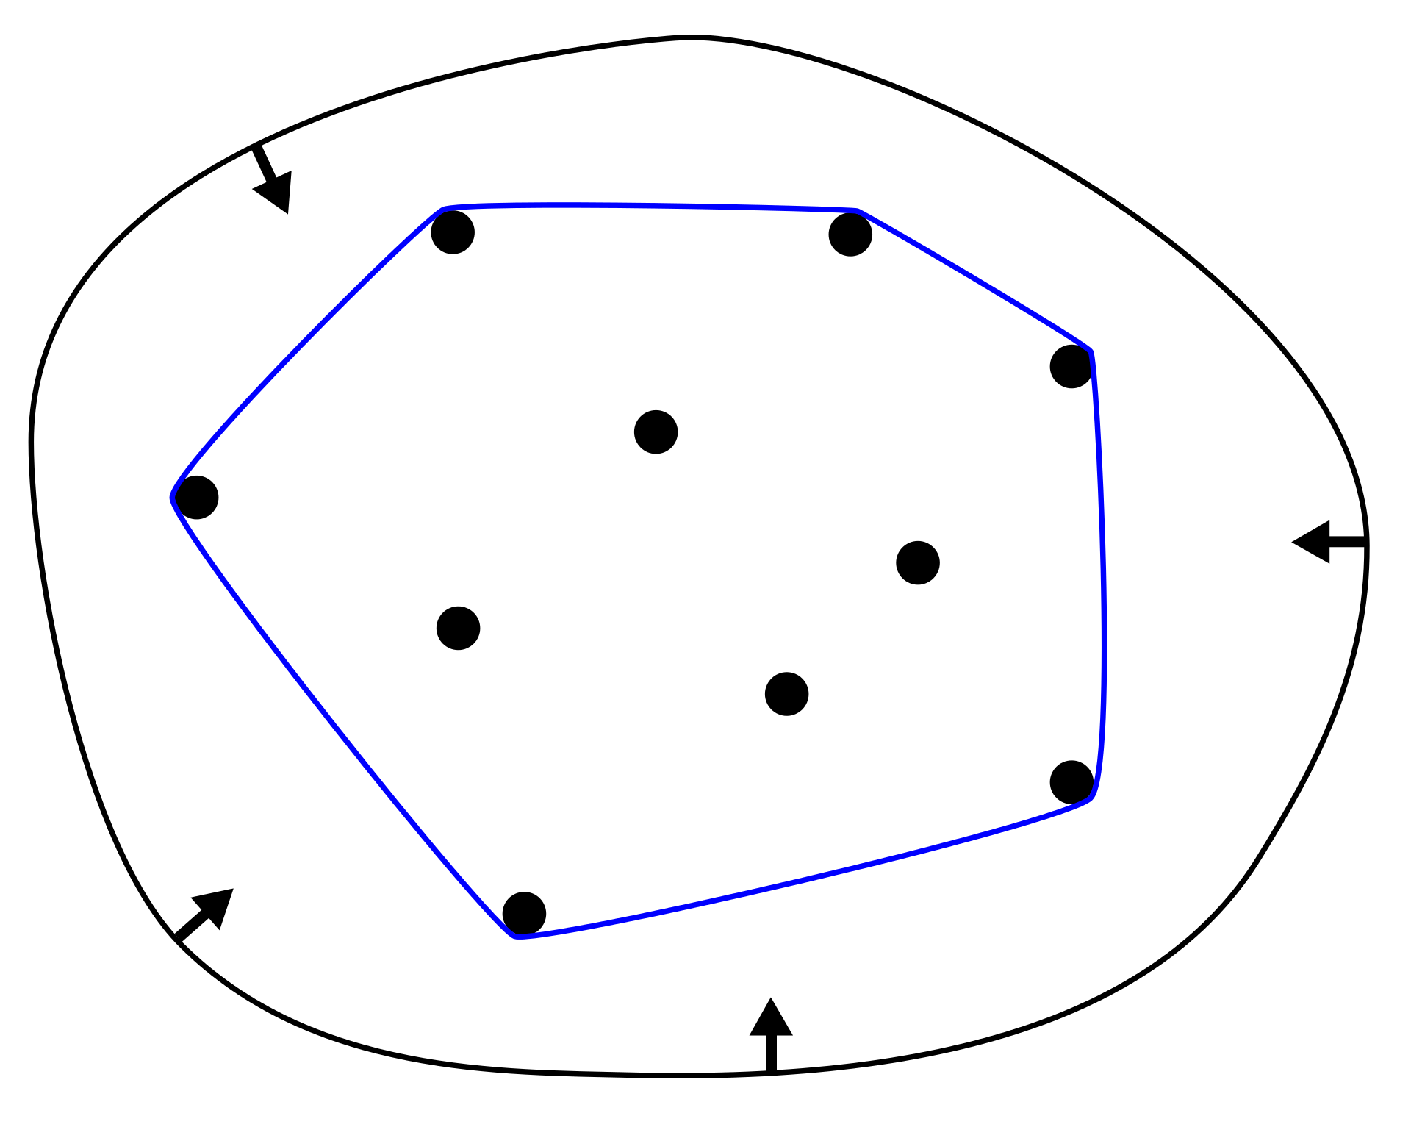
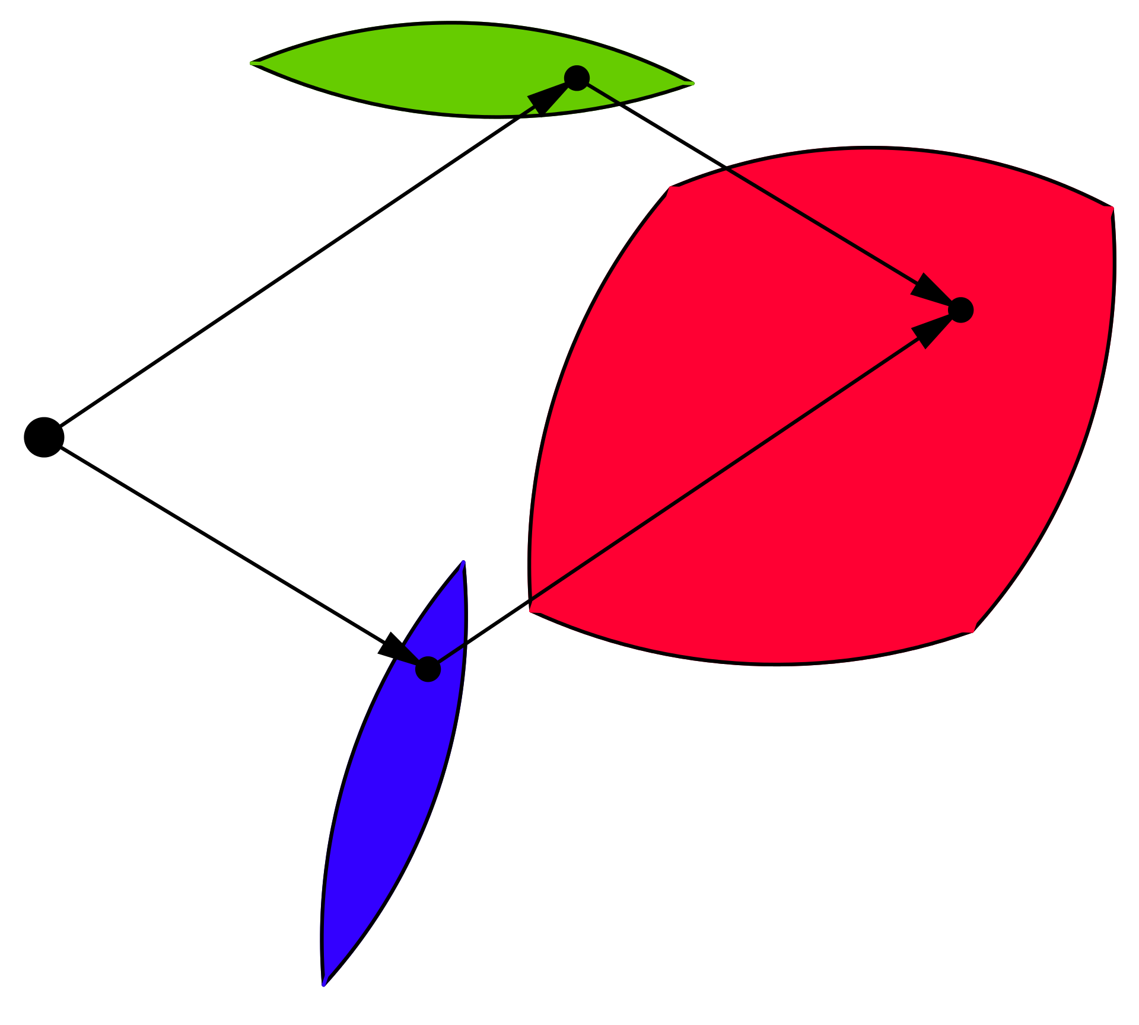
Convexity of friction forces
Mark will draw some friction cones on the whiteboard and talk briefly about why friction constraints are “convex” and why reasoning about frictional forces leads to convex addition of force vectors:
Convex Hull of wrenches
Minkowski sum of wrenches
Fy
Fx
https://en.wikipedia.org/wiki/Minkowski_addition
https://en.wikipedia.org/wiki/Convex_hull

Slide 30
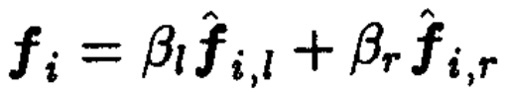
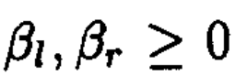
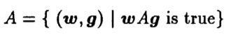
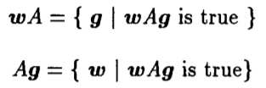
Setup: friction cones
Notation in the paper:
What it means:
Just specifying the normal force doesn’t fully tell us the actual contact force (which could be anywhere inside the friction cone) or the wrench that can be resisted.
2D:
If wrench w can be resisted by g
Notes:
In the planar case, for each contact the force, fl and fr are unit vectors along the boundaries. Fi is given by a convex combination of forces along the extrema of the friction cone

Slide 31
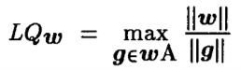
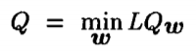
How good is the grasp?
Notation in the paper:
What it means:
The quality of our grasp is the best we can perform in the worst case scenario.
For any given wrench direction, the best ratio between resulting wrench and applied finger force
But we’re only as good as in the wrench direction we’re the worst at resisting.

Slide 32
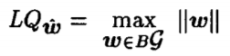
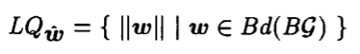
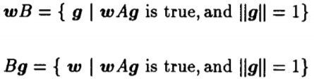
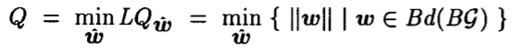
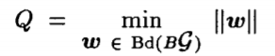
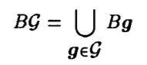
Normalizing g
What about scaling rotations versus translation (or torque versus force)? ⇒ lambda scaling factor
We can then rewrite LQ as:
Wrenches and applied forces scale linearly with each other, so we lose nothing by setting the norm of g to 1
We only consider wrenches on the boundary of BG, so only the wrenches that can barely be withstood by our unit g
We’ll see that how we define this matters
We can define these new sets with unit g:
Our metric Q then becomes:
The magnitude of the biggest wrench our unit grasp can withstand in the direction we are the worst in
Notes:
Taking the max value of the wrench module means ...so that Q becomes the maximal magnitude of wrench that could be resisted in the worst direction, we can state that some directions where the reaction wrench can be greater but we want to be assured we get a lower bound over all directions

Slide 33
Computing the quality metric
To compute this best-in-the-worst-case quality metric, we exploit the convexity of the friction cone
Every possible contact force is a convex combination of the vectors on the boundaries of the friction cone
Every possible wrench exerted by a contact lies within the convex hull of the wrenches exerted by forces at the boundaries of the friction cones

Slide 34
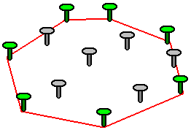
Computing the quality metric
To compute this best-in-the-worst-case quality metric, we exploit the convexity of the friction cone
Every possible contact force is a convex combination of the vectors on the boundaries of the friction cone
Every possible wrench exerted by a contact lies within the convex hull of the wrenches exerted by forces at the boundaries of the friction cones
https://www.webdepot.umontreal.ca/Usagers/p1038321/MonDepotPublic/ift3150/avancement.html

Slide 35

Building the wrench space
If we plot the wrenches that correspond to the boundaries of the friction cones and take the convex hull, we get a wrench space.
3D for a planar case
6D for a 3D case
Somewhat conservative. Weights all wrench directions equally.
The quality of the grasp is then the radius of the biggest sphere centered at the origin that will fit inside of our wrench space.
Li and Sastry propose using task ellipsoids that weight particular wrench directions more.
Ferrari, Carlo, and John F. Canny. "Planning optimal grasps." ICRA. Vol. 3. 1992.
Notes:
Make a note about task ellispoid

Slide 36




Defining ||g||: two quality metrics
Minimizing the Maximum Finger Force (Linf)
Minimizing the Maximum Total Force (L1)
The wrench resulting from a force at the m^{th} friction cone boundary at the i^{th} contact
All possible resultant wrenches on the object if every finger is exerting a force on the boundary of a friction cone
All possible wrenches on the object if any one finger is exerting a force on the boundary of a friction cone
Notes:
These formula give a fast way to compute the metric starting from the primitive wrenches that describe each contact, the metric Q is the distance of nearest facet of the convex hull from the origin in wrench space.

Slide 37

Other metrics: adjust weight for expected task forces
Li, Hsu, Sastry, “Grasping and Coordinated Manipulation by a Multifingered Robot Hand,” IJRR 1989. Create an ellipsoid in task space with axes adjusted to match expected directions of maximum and minimum wrenches. Then map this ellipsoid to contact space to evaluate the grasp. If desired can also map to joint space.

Slide 38


GraspIt! (https://graspit-simulator.github.io/ )
A grasp analysis system that makes use of the Ferrari-Canny grasp metrics.
Rather than allowing any choice of finger placement, it takes into account geometry and kinematics of the hand being used.

Slide 39


GraspIt!
We have determined the better grasp possible based on location and forces at contacts
Can we really achieve this configuration by using a particular kind of manipulator geometry?

Slide 40


GraspIt!
In Miller & Allen’s work, they investigate the quality of the grasp of an (old) telephone while using two different manipulators.
Barret
Grasp quality parameters:
ε: radius of the maximum sphere inscribed in the convex hull of wrenches
V: total volume of the convex hull
DLR

Slide 41
GraspIt!
In Miller & Allen’s work, they investigate the quality of the grasp of an (old) telephone while using two different manipulators.
Barret
Grasp quality parameters:
ε: radius of the maximum sphere inscribed in the wrenches convex hull
V: total volume of the convex hull
DLR

Slide 42
GraspIt!
How is the contact simulated?
They considered three different finger-object material combination:
Metal finger - Plastic object
Plastic finger - Plastic object
Rubber finger - Plastic object
It changes the friction cone!

Slide 43
GraspIt!
How is the contact simulated?
There are three kinds of contact:
Punctual
Linear
Planar
Nguyen [9] points out that these complex contacts (linear and planar) can be represented as the convex sum of proper point contacts at each of the vertices of the surface patch.

Slide 44
GraspIt!
How is the manipulator and object interaction simulated?
Wrist joints (i.e. palm orientation) set constant
Spread joint set constant
Palm-proximal (PP) actuated
Proximal-distal phalanges (PD) joint not directly actuated
PP joint free to move until it the proximal link collides with the object or Range Of Motion (ROM) of the joint exceeded
PD joint continues to rotate until the distal link collides with the object or ROM joint exceeded

Slide 45

GraspIt!
How are the forces simulated?

Slide 46


GraspIt!
How is the convex hull computed?
Constraint: the sum of the magnitudes of all the contact forces is less than or equal to 1
(alternatively: set each magnitude to be unity, giving
them equal weight)

Slide 47

GraspIt!
They also try to provide a visual representation of the 6-DOF wrenches’ convex hull. They divided it in two different 3D convex hull projections, one for the forces and one for the torques.
Forces convex hull:
Torques set equal to the ones corresponding to the worst wrenches possible (the nearest facets of the convex hull to the origin)

Slide 48
GraspIt!
They also try to provide a visual representation of the a 6-DOF wrenches convex hull. They simply divided it in two different convex hulls, one for the forces and one for the torques.
Torques convex hull:
Forces set equal to the ones corresponding to the worst wrenches possible (the nearest side of the convex hull to the origin)

Slide 49
GraspIt!
This way, we can determine visually which external force disturbance directions are the most troublesome to resist in the grasp configuration given, in terms of both forces and torques

Slide 50


GraspIt! - Grasp 3
We focus on the most stable grasp. It was determined choosing from a subset of grasps: setting the x palm coordinate they varied y and z while computing ε. They choose the y and z position which gave the best ε (i.e. proximal to 1)

Slide 51

GraspIt! - Results
They also simulate the grasp with the DLR manipulator for comparing the two hands grasp performances. They finally verified that the third grasp was the best (Table).
The software is able to:
Provide visual simulation of a grasping task with different manipulators and different materials in different configurations
Easily visualize 6-DOF convex hulls of force and torque wrenches
Compute ε and v performance parameters to compare different grasps

Slide 52
GraspIt! - Demo
YouTube video of using GraspIt! with a two-fingered industrial gripper to evaluate possible grasps on a block:
https://youtu.be/2AyQYCc4HRo

Slide 53
Assignment Summary
Q1: Consider, for a simple case, why the Yoshikawa and Nagai definition of grasp force makes more sense intuitively. Answer the questions that go with a simple Python script, Left-Right-GraspMatrix.py
Q2: Use the Python script ConvexHullUnion.py to examine how coefficient of friction and finger placement affect the quality of a grasp (as defined by Ferrari and Canny).
Optional: For comparison you can also look at the same problem using the more “optimistic” Minkowski Sum metric using ConvexHullMinkowski.py

Slide 54

Example: grasping a trapezoid with friction
Assignment Q2:
What value of mu will make this an acceptable grasp per Ferrari/Canny/ Miller/Allen (i.e., such that wrench convex hull encloses origin)?
What if we add a 4th finger? Where should we put it?

